Slide 1
Kubernetes course

Slide 2
What is container

Slide 3
What is container?
Container is executable unit of software containing all necessary code and configuration which is needed for full deployment
Container is not Virtual Machine
Containers are form of Operating system virtualisation

Slide 4



What is virtualisation?
Is abstraction process which allows to share hardware resources of single instance across multiple virtual instances

Slide 5
Virtual machines
SQL
REST API
SMTP
Bin Libs
Bin Libs
Bin Libs
Guest OS
Guest OS
Guest OS
Hypervisor (VMWare, Virtualbox ..)
Server OS
Server Hardware

Slide 6
Problems with VMs
VM’s are quite big (couple of GBs)
Deploying a VM takes time (Although the public cloud ones are pretty fast)
Modern development is FAST

Slide 7
Containers
Container
SQL
REST API
SMTP Server
Bin Libs
Bin Libs
Bin Libs
Container engine (Docker, LXC ..)
Server OS
Server Hardware

Slide 8
Container
It is Just a process sharing host OS (with other containers).
It’s lightweight (as small as couple of MB’s) and its fast to start.
It’s easy to manages.

Slide 9
Container is more general concept than Docker
Docker is just one platform for working with containers.
Docker competitors 2023:
LXD/LXC (Canonical)
Podman
Kaniko
Buildah
OCI (Open Container Initiative): is a group created with the goal to formalize and standardize containers.

Slide 10
Rest of this course focuses primarily on Docker containers

Slide 11
Docker

Slide 12
What is Docker
Is currently the most popular platform for containers.
Docker team is founder of OCI (open container initiative).

Slide 13
What is Docker container
Docker container is running instance of Docker image.
Docker container is just a process which includes everything (files, drivers, config..) to run the application within it.

Slide 14
What is Docker image?
Is an unchangeable file with all resources to run specific application.
It consists of immutable layers (other files).
It is a template to create the docker containers.

Slide 15
How do we store images
Images are files like anything else.
For convenience we store them in registries.
Docker registry is like a git for source code.
DockerHub is one of the most popular public places to store images.
Public images can be used by anyone to create containers.
Public images can be extended with custom layers.

Slide 16
DEMO - Docker installation
https://docs.docker.com/engine/install/ubuntu/

Slide 17
Docker image preparation

Slide 18
Demo app
Django Rest Framework school-project
https://github.com/misohu/django-tutorial (leave a follow please and star :))
Core functionality
API on top of relational database
3 interconnected tables (subjects, teacher, students) representing university information system
Can speak to Sqlite DB and Postgres DB

Slide 19
Scenario
Create Dockerfile for API image
Build the image with two tags (one for sqlite and postgres implementation)
Publish the image into a public repository (find mine at: https://hub.docker.com/r/misohu/django-school-project)

Slide 20
Demo
$ cd 002_bilding_images

Slide 21
What is Kubernetes

Slide 22
So what is kubernetes?
Open source orchestrator for deploying containerized applications (developed by Google 2014).

Slide 23
What really means to orchestrate?
We have an app made of microservices (understand small components) like:
Frontend
Backend
Database
Cache
et.c
We have a fleet of virtual machines and we want to distribute the services to those machines

Slide 24
Why don’t we run it all on one machine?
What if the machine fails?
What if the machine is not big enough or will not be big enough?
What if one service needs Python 3.8 and the other needs python 3.11
What if one service may have security vulnerability which will leak passwords from DB (other service).
Other what ifs.

Slide 25
Kubernetes solves
How will be the services deployed?
What happens if one service stops working?
How will be services communicating with each other?
How do I clone one particular service?
How to separate services?
How to handle accesses to the services?
And many more

Slide 26

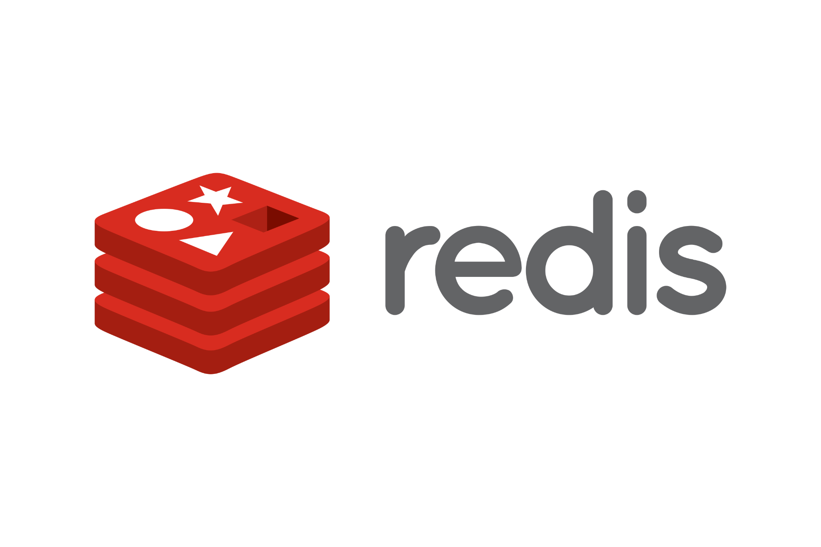




Slide 27
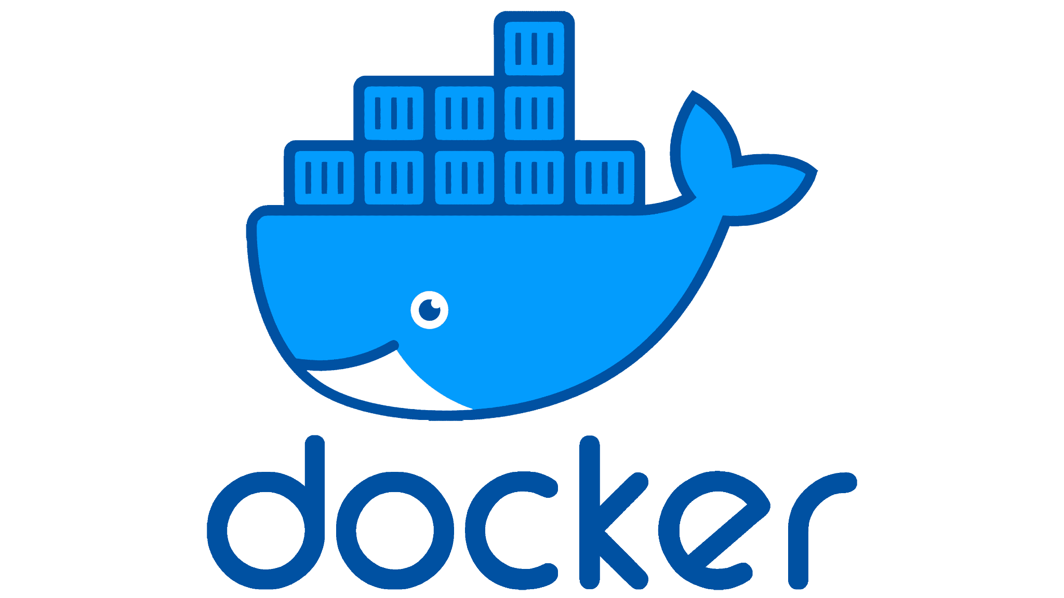


Slide 28
Kubernetes immutability
Just like containers also kubernetes resources, once they are created no one can change those. Only new ones can be deployed.
This significantly improves the deployment problems with speed.
Thanks to this CI CD tools can be used for the deployments.

Slide 29
Kubernetes’ declarative configuration
Imperative style
Run installation of dependencies.
Run this installation script for service A.
Run some other thing.
Declarative syntax
At the end of deployment I want service A to be deployed with following config.

Slide 30
Self healing Kubernetes
If node (the virtual machine behind) will fail. Workloads (services and configuration) will be seamlessly deployed to other nodes.
If one service health checks will start to fail, the service will be restarted.
If one service will stop responding, its copy will be created.

Slide 31
Separation of concerns
Each piece in Kubernetes abstraction is independent.
Everything is connected through load balancers
You can anytime take the cluster and move it somewhere else:
AWS
Azure
GCP
Self hosted cluster on Premise
Arduino Cluster

Slide 32
Scalability
It is so easy to scale the service in the cluster up and down manually and automatically as you wish.
It is also possible to scale the nodes in the cluster as you need

Slide 33
Kubectl installation

Slide 34
What is kubectl
Your new best friend
Its command line tool which allows you to speak to kubernetes cluster
Most of the configuration we will do will be with kubectl

Slide 35
Demo
$ cd 003_kubect_installation

Slide 36
Microk8s installation

Slide 37
What is Microk8s
Canonical’s project for low weight kubernetes deployment.
It’s perfect for local experimenting.
It is not Kubernetes itself (it abstracts away some complicated configuration).
We will be running single node setup although there is support for multi node.
Microk8s provides Addons which helps to setup some complicated setups of normal Kubernetes (load balancer, ingress, dns setup, RBAC, GPU and more).

Slide 38
Demo microk8s setup Ubuntu
Prerequisites:
Ubuntu machine (or any OS supporting snap).
$ cd 004_microk8s_installation

Slide 39
Microk8s alternatives
Minikube
Kind (Kubernetes in docker)
K3D (my favorite)
You can use for you local development anything you want. I will continue with demos with microk8s.

Slide 40
AWS account setup

Slide 41
Demo
https://aws.amazon.com/console/
Create account (verify email)
Add payment method (verify card)

Slide 42
AWS EKS setup

Slide 43
What is EKS
Elastic Kubernetes service.
Kubernetes as a service.
You pay AWS for managing and maintaining you Kubernetes cluster.
There are two options currently:
Running on top of EC2 instance (this option we will use).
Running on top of Fargate (fargatre is a compute engine, run your app without instance).
Behind the scenes EKS will create our ec2 instances create the connections between those and install kubernetes.
You don’t have control of the control plane nodes

Slide 44
Pricing for EKS
It depends on multiple factors but I will try to do rough estimate for EC2 with default setup in Frankfurt region.

Slide 45
AWS cli setup
(Optional but recommended) create non root admin account
Get AWS credentials: https://docs.aws.amazon.com/singlesignon/latest/userguide/howtogetcredentials.html
Download AWS CLI
https://docs.aws.amazon.com/cli/latest/userguide/getting-started-install.html

Slide 46
Install EKSCTL
EksCtl is command line tool for EKS (elastic kubernetes service).
It allows you to manage AWS kubernetes clusters directly form you command line.
Installation https://docs.aws.amazon.com/eks/latest/userguide/eksctl.html

Slide 47
EKSCTL demo
Prepare that the creation of the cluster takes around 20 minutes and you will be paid since the cluster started.
I recommend starting examples with microk8s (or other local setup) and when you are ready head to EKS CTL.
Strategy I recommend is to allocate few hours for EKS experimentation after which you delete the cluster.
$ cd 005_eks_demo/

Slide 48
Kubernetes components and concepts

Slide 49
Kubernetes nodes
Nodes are the machines which create the cluster.
The upper limit of nodes is around 5000 currently (really an edge case custer).
Types of nodes:
Master/controlplane nodes (key Kubernetes workloads are presented here).
Worker nodes (application workloads are here).
Normally application workloads should not be scheduled on master nodes.

Slide 51
Kube api server
Everything in the Kubernetes is a resource (REST).
Kube api is REST api which we will talk to manage our cluster.
It’s like a Frontend to the cluster.
Kubectl is the local client which we will use to talk to the Kube api server.
Normally Kube-api runs as a pod (lets think container for now) on control plane node (it can also run as a system service through systemd).
Now you need to understand that on EKS or any other managed kubernetes services the control plane is hidden. We can only see the worker nodes.

Slide 52

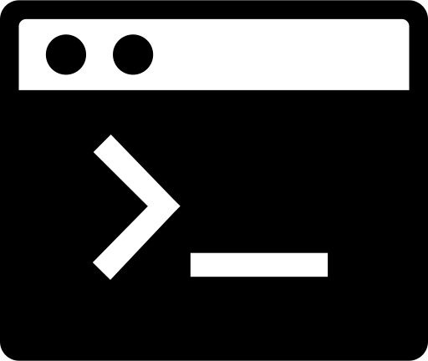
Controlplane
Kubectl

Slide 53
Etcd (distributed key value storage)
Manages configuration data and state data of objects in kubernetes.
Etcd should be used only to store data related to kubernetes objects.
Kube-api-server speaks directly to ETCD you don’t have to.
Its located mostly on control plane nodes (notice the plural).
Its super fast (benchmarked at 10 000 writes per second).
Uses Raft protocol (makes it super reliable).
Microk8s uses Dqlite as its database (HA Sqlite alternative).

Slide 54
Kubelet
Kubelet is the hearth of every Kubernetes node.
Is the agent running there handling all the magic.
Kubeapi speaks with other nodes through kubelet.

Slide 55

Worker 1
Controlplane
Worker 2
Kubelet
Kubelet
Kubelet

Slide 56
Other core components (details in later videos)
Kube proxy - Responsible for load balancing traffic between workloads.
Kube scheduler - Scheduling of pods.
Kube dns - DNS resolution for Kubernetes objects.
Kube Controller manager - Control loop monitoring state of the cluster.

Slide 57
Kubernetes namespaces

Slide 58
Problem
Imagine having one cluster for multiple teams at work.
Cluster consists of few nodes.
You want seamlessly deploy both application of these teams without interference:
You could create two clusters but that would be more expensive and more maintenance.
You could give x nodes to team A x nodes to team B but having Kubernetes allows you to simultaneously use all resource in all teams.

Slide 59
Kubernetes namespaces
Abstraction in Kubernetes solving aforementioned problems.
The separation can be done on node level (Team A uses nodes 1, 2 and team B uses 1,3).
The separation can be done on resource level (Team can use Up to 128GB or Ram from the whole pool) etc.
You can operate in the context of namespace or the whole cluster.
$ cd 006_namespaces_basics

Slide 60
Communication with kube-api

Slide 61
Controlplane
Kubectl

Slide 62
Secure communication
Kube-api-server its a REST API which kubectl (client) talks to.
Kubectl is written in go (just like most of the kubernetes).
In order to securely talk to API we need kubeconfig
Kubectl first checks is the KUBECONFIG env is set up (it has full path to the config).
Kubectl first looks for config at ~/.kube/config.
If none of above you can specify custom config at the kubectl command calls.
$ kubectl get ns --kubeconfig=/path/to/config

Slide 63
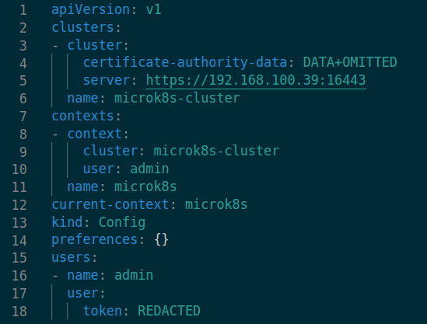

Slide 64
Cluster section
Specification of all available clusters for give config (you can have more cluster specified to easily switch between).
Server: is the location of the kube-api (can be specified also with tls-server-name).
certificate-authority-data: PEM encoded certificate authority (can be empty, then system’s CA will be used).
(other):
insecure-skip-tls-verify: can be set to True and then no TLS communication will be used.

Slide 65
Users section
User is an abstraction in Kubernetes used for Authentication (we can grant access to the cluster with them).
There might be three types of authentication data provided (under user:):
token: for token based authentication
username:/password
client-certificate-data:/client-key-data: which contains base64 encoded contents

Slide 66
Context section
Cluster: reference to one of the clusters.
User: reference to one of the users.
Namespace (defaul: default): reference to one of the namespaces in the cluster (we may have access in the context of namespace).

Slide 67
Other sections
Kind: specifies the type of kubernetes object (every object must have type).
ApiVersion: each object in kubernetes is using some api to create itself (each object may be created with different version of api). This is also mandatory field.
current-context: specifies the current context we are operating in (this field has value from one of the names in context section).
properties: {} -> this is an empty key (optional no needed).

Slide 68
Kubernetes config Demo
$ cd 007_kubeconfig

Slide 69
Setting up autocomplete and VSCode

Slide 70
Autocomplete
Kubectl comes with some nice autocomplete functionality.
Relying on autocomplete or extensions is not good idea.
$ cd 008_autocomplete

Slide 71
Kubernetes Pods

Slide 72
What is Pod?
Smallest deployable unit of computing in Kubernetes.
It is the application in the cluster.
Example
Imagine we want to deploy nginx into cluster (NGINX is a web server but you think of any other app).
How we do that?

Slide 73
Example Nginx
We need a NGINX image (docker image here).
We need cluster.
We need a way to tell cluster to deploy the container as a pod to the cluster.
$ 009_pod_basics

Slide 74
pod-example
$ kubectl create ns pod-example

Slide 75
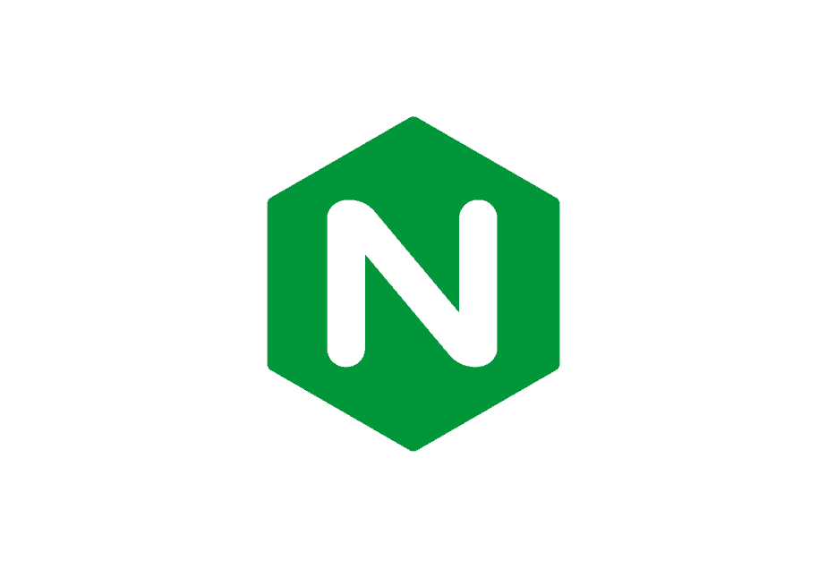
:80
nginx-pod
pod-example
$ kubectl run nginx-pod --image=nginx --port 80

Slide 76
:80
:8080
nginx-pod
pod-example
$ kubectl port-forward nginx-pod 8080:80

Slide 77
What really happened?
Kubectl sent request to the kubernetes api server resource which is responsible for handling Pods.
Kube scheduler chose the node where the pod was deployed.
Run kubectl get po -o wide to check on which node the pod was deployed.
Kubelet tried to get the pods image from the local nodes registry.
Because we are running the nginx for the first time the image is not there.
(If image is not there) kubelet tries to pull the image from default image registry (Dockerhub in this case).
Kubelet runs the container in the pod.

Slide 78
So the pod is a container ? NO!!
Pod is not a container.
Pod can be a container or a set of containers.
Single pod is deployed on a single node (sometimes it makes sense to group containers).
Containers in the pod may share some volumes (file system), hostname, ip address, port space and they share number of Linux namespaces.
Having multiple containers in the same pod is ideal for tightly coupled apps.

Slide 79
Examples for multiple containers in pod
Gyt sync pattern: you have main app in one container and in other container you will run synchronization process which will update some files needed for the main app (e.g. the config of nginx server).
Sidecar logger: you have main app running in one container and the other container is responsible for gathering logs from the main container and sending them to centralised datastore (e.g. logstash).
Sidecar for service mesh: You have main app in one container and the other container is handling networking.

Slide 80
Kubectl usage

Slide 81
We start to notice some patterns
kubectl get namespaces
kubectl get pods
kubectl delete namespace X
kubectl delete po X

Slide 82
Kubectl commands structure
$ kubectl [command] [resource] [name] [flags]

Slide 83
What is resource?
I am talking about resources in context of REST API.
Some articles may call those kubernetes objects or kube-api endpoints.

Slide 84
Kubectl commands
get/describe: to get info about some resource (READ).
run/create/apply: to create some new resource (CREATE).
edit/apply/patch: to update some resource (UPDATE).
delete: to remove some resource (DELETE).

Slide 85
Kubernetes resources
pods
namespaces
services
replica sets
daemon sets
stateful sets
deployments
configmaps
secrets
ingresses
and many more which we will cover

Slide 86
Demo
$ cd 010_kubectl_commands

Slide 87
Declarative vs imperative

Slide 88
Imperative
So far all the communication with kubernetes api server so far was through imperative commands:
kubectl run nginx --image=nginx
kubectl delete ns namespace
Imperative means that we are strictly ordering what to do one by one.
Clear instructions what to do in what order.

Slide 89
Declarative
We define just the end (expected) outcome.
We trust the process.
We just say what we want.

Slide 90
Declarative in Kubernetes
We use kubernetes manifest files (yamls, sometimes I will use the word object).
We send those manifest files to API server and we leave the work to Kubernetes.

Slide 91
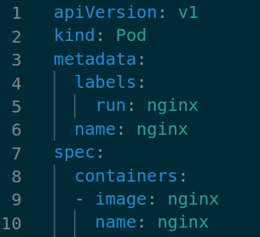
imperative
$ kubectl run nginx-pod --image=nginx --port 80
nginx-pod.yaml
declarative
$ kubectl apply -f nginx-pod.yaml

Slide 92
Declarative is the best !!
Imperative leads to a lot of misconfigurations (many times it is hard to replicate correct order of steps, it’s even harder in teams).
Declarative approach leads to single source of truth (the manifest file).
Easy to store in source control.
Easy to collaborate on.
Easy to version.

Slide 93
apiVersion
When we create resources we talk Kubernetes api. Api may support different versions for different resources (e.g. for experimental features of backwards compatibility).
You can always check online the spiversion for different resources.

Slide 94
kind
Is the resource type we want to create (uses always CamelCase).

Slide 95
metadata
Is data about data section.
Name is always mandatory:
Must be a valid dns subdomain !!!!!!
Contain no more than 253 characters.
Contain only lowercase alphanumeric characters, '-' or '.'
Start with an alphanumeric character.
End with an alphanumeric character.
Labels helps to organize kubernetes resources into groups (more about it later).

Slide 96
spec.containers
Its place where we define containers.
In this case we have one container with name and image nginx.

Slide 97
Demo with ports
$ cd 011_declarative_example

Slide 98
Debugging pods

Slide 99
Why to debug
Sometimes (almost always) code does not work as it supposes to.
Kubernetes provides tools to debug pods.
Types of problems:
Problem with kubernetes deployment.
Problem with the application.

Slide 100
Problem with Kubernetes
You can always get any resource you think it’s broken.
If you need more information you can describe particular resource by the resource name.
$ kubectl describe pod pod-name

Slide 101
Pod’s Status
Pending:
Complpex state saying that pod may not be scheduled yet (node has not been chosen).
Or that the containers are not read (you may see status ContainerCreating).
Running:
Scheduled and at least 1 container still running.
Succeed:
All containers ended with OK (pod won’t be restarted).
Failed
All containers are terminated and at least one with failure.
Unknown
Can’t speak to pod (most likely network problem).

Slide 102
Problem with the application
Here Kubernetes allows us to check the application logs with logs command.
We can also exec into the running pod to examine the pod.

Slide 103
Ephemeral pods
Kubernetes pods are designed to be ephemeral
When they are gone they are gone (there is no way to create exactly same pod).
Pods are unique even if they run the same application.
If you exec into pod and do some changes the changes won’t persist the pod restart.
Pod restarts are normal and you may not even notice them.
Use the exec with caution.

Slide 104
Demo
$ cd 012_debugging_pods

Slide 105
Overriding Container command and entrypoint

Slide 106
Problem
Sometimes containers come with binaries which we want to run in different way as the default is.
There is small naming discrepancy between Docker and and Kubernetes in terms of container commands.

Slide 107
Custom pod command
Docker images may come with CMD and ENTRYPOINT set.
You can override this with spec.containers[i].command and . args.

Slide 108
Demo
$ cd 013_command

Slide 109
Resource limits and requests

Slide 110
Each cluster comes with limited resources
Organising pods into nodes its like building lego bricks with roof limits.
Kubernetes scheduler is the one responsible for choosing a node for a given pod.
Resource limits and requests helps us to put constraints on pods and their resources.

Slide 111
Problem
Imagine having a pod which we want to schedule.
Which of the given nodes the Pod should be placed?
What is the minimal amount of RAM and CPU that the node needs?
What if node will have some problem causing it to use way too much resources.

Slide 112
Units in Kubernetes
CPU
“1” - one vCpu
“0.5” - one half vCpu
“500m” - 500 milicores of VCPU == 0.5
RAM
1 MB = one Mega bite = 1024KB
1 Mi = one Mebi bite = 1000KiB
1 mB = one Mili bite
1 MB = one Megabite

Slide 113
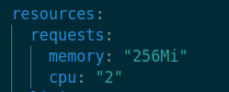
Resource requests
Specifies what is the minimum resources needed to run the pod:
No nodes with less available resources will be chosen.
Kubernetes guarantees that those resources will be available if scheduled.
We specify it on container level.

Slide 114
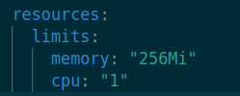
Resource limits
Sets the maximum resources given container can use.
If the container uses more it will be killed.
We specify it on container level.

Slide 115
Demo
$ cd 014_resource_request_limits

Slide 116
Liveness probe

Slide 117
Liveness probes
Sometimes the app goes to broken state without crashing.
Liveness probe is the mechanism to detect this state.
Liveness probe is regular check against process which runs.
If it fails pod is restarted.

Slide 118
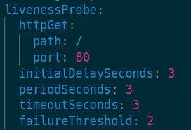

Slide 119
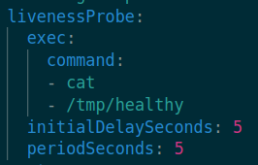
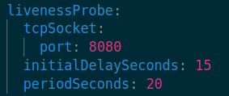
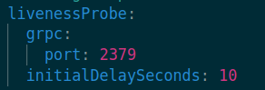
Other types

Slide 120
Demo
$ cd 016_readyness_probes

Slide 121
Readiness and startup probes

Slide 122
Startup probe
Is used to indicate that the app in container has started.
Sometimes apps take time to start and we don’t want to use the app before it’s ready.
If the startup probe fails Container is killed
Depending on the spec.restartPolicy the pod may be restarted
Same type of probes as liveness can be used with same params.
Must be created in YAML.

Slide 123
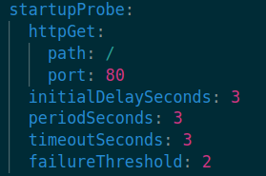

Slide 124
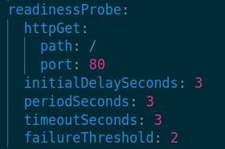
Readiness probes
These probes are executed after startup success (and throughout lifecycle).
Helps to indicate if the application is ready.
Request to the app won’t be served until the readiness passes (also liveness probes won’t be executed before success of readiness).

Slide 125
Example use case differences
Imagine having API for serving some ML model
First we need to start the app (it takes some time between 3 to 5 mins). We will create startup probe to check for the startup. For example after startup some file will be located at some path in the container. We need to set big enough period time and retries
After app is deployed it loads some ML model from remote storage before serving the requests. We use the readiness probe to estimate when to start the traffic to pod
Now the traffic is being served but we know there is a chance something wrong can happen on one of those HTTP endpoints. So we set the liveness probe to check for status codes of those endpoints (HTTP probe fails is the status code is above 400).

Slide 126
Important
Kubernetes performs other Health checks outside probes
It checks if the process in container is running
If it has finished with error status code
checks if the ip is available
and more
This checks are for free and are used to heal the pod

Slide 127
restartPolicy
Restart policy is used on containers failure.
Use with caution because might end in the chain of restarts (although exponential backoff if used 10s wait 20s wait 40s wait etc.).
Values:
Always (default)
OnFailure
Never

Slide 128
Demo
$ cd 016_readiness_probes

Slide 129
Labels and annotations

Slide 130
Labels
Kubernetes is designed to organize large scale distributed systems with hundreds of components.
We need to organize multiple teams with different apps.
Labels is a metadata field used for grouping objects.

Slide 131
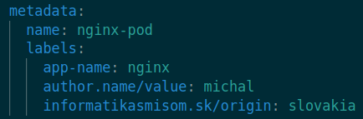
Rules
Labels is a list of key: value pairs.
Key
Can be in a form of prefix/name (prefix/ is optional)
Prefix must be valid DNS subdomain with 253 chars (can have dots)
Label 63 chars for name part
Alphanumeric character ([a-z0-9A-Z]) with dashes (-), underscores (_), dots (.)

Slide 132
Where can we use labels?
Labels can be part of any Kubernetes resource.
We can apply labels to already running resources imperatively.
This is not recommended as we might forget to update the manifest.
We can also apply labels to nodes (this is very common).

Slide 133
Label selectors
key=value | where key has value
key!=value | where key does not have value
key in (value1, value2) | where key has value from group
key notin (value1, value2) | where key has not value from group
key | where key has some value
!key | where key does not have value

Slide 134
Annotations
Is a list of key: value pairs.
For non identifying information.
Data which is not used for grouping.
It’s used for some extra application data (e.g. gui values).
It’s important for keeping track of historical changes !!!
We will be talking more about annotations in rollbacks video.

Slide 135
Demo
$ cd 017_labels_annotations

Slide 136
ReplicaSets

Slide 137
High availability
Highly available application is application which can face disruptions on node level or application level. e.g.:
One of the nodes is down but the app is scheduled also on other nodes.
One of the pods is having problems but the app has still some replica.
Kubernetes allows HA applications.

Slide 138
Concept stateless pods
Having an application (e.g. backend API) we will create copies of the same pod called replicas.
These pods will be created from same template but will be unique Kubernetes objects.
Pods won’t have state (it does not matter in which order they are created or how many of them there are, they all behave the same).

Slide 139
ReplicaSet
Replica set is Kubernetes object responsible for managing group of pods.
Pods belonging to given replicaSet are specified by label selector.
Replica set does not own pods. It just refers to those with labels. Pods are independent piece.
We will talk how i load distributed across these pods in later videos.

Slide 140
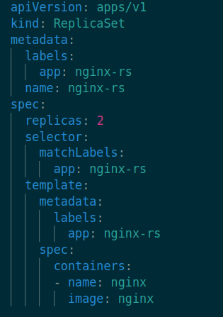
Pod template

Slide 141
Label must match the label of pod
in the template

Slide 142
Reconciliation loop
We submit the manifest which will be received by api server and will be written to etcd.
Kubernetes checks if the number of pods specified in replica set is presented in cluster.
If not It will schedule missing pods or delete extra pods based on the pod template and labels.
This loop runs endlessly.

Slide 143
Demo
$ cd 018_replicaset

Slide 144
Deployment

Slide 145
Problem
Imagine you are running a massive ReplicaSet in your cluster with tens of pods and millions of users.
Each pod is running version 1 of your application.
Now you want to upgrade to version 2 seamlessly without customers noticing .
How do you handle this?
What if the new version fails?
How do you rollback?

Slide 146
Deployment
Is a wrapper around ReplicaSet.
It helps with deployments.
We can specify strategy which will be used during update.
We can simply rollout to previous version of deployment.

Slide 147
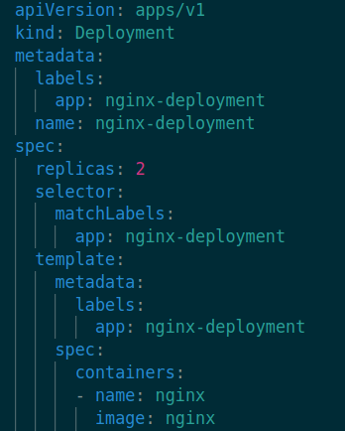

Slide 148
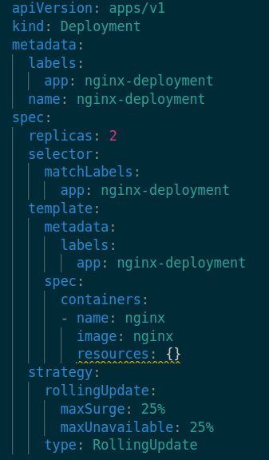
Update strategy
Strategy specifies how to update the ReplicaSet.
Recreate: shuts down all pods and starts new with new version (downtime of application).
Rolling update: gradually changes the versions of pods:
MaxUnavailable: how many of pods will be updated at the same time (can be number or percentage).
MaxSurge: How many new extra pods will be created during update.

Slide 149
MaxUavailable 25%
pod1: version1
pod1: version1
pod1: version1
pod1: version1

Slide 150
MaxUavailable 25%
pod1: version1
pod1: version1
pod1: version1
pod1: version2
Probes OK

Slide 151
MaxUavailable 25%
pod1: version1
pod1: version1
pod1: version2
pod1: version2
Probes OK
Probes OK

Slide 152
MaxUavailable 25%
pod1: version1
pod1: version2
pod1: version2
pod1: version2
Probes OK
Probes OK
Probes OK

Slide 153
MaxUavailable 25%
pod1: version2
pod1: version2
pod1: version2
pod1: version2
Probes OK
Probes OK
Probes OK
Probes OK

Slide 154
Be careful
By running Rolling Updates at certain point in time there are two versions of the same application available in the cluster.
Traffic in the cluster is split across pods so there is a chance some customers may get old version while others the new one.
Other service talking to this app must be able to speak with the app in both versions!!!

Slide 155
Demo
$ cd 019_deployment

Slide 156
Rollbacks

Slide 157
Motivation
Sometimes (a lot of times) things go wrong.
Kubernetes has a way to undo the changes for given deployment.
Rollback is the mechanism.

Slide 158
How it works?
Everytime we do some change with deployment Kubernetes stores the historical manifest in the same object.
This history is stored in annotations field.

Slide 159
Kubectl
Command for handling rollobacks is called rollout.
$ kubectl rollout history

Slide 160
Demo
$ cd 020_rollbacks

Slide 161
Scaling in Kubernetes

Slide 162
Vertical scaling
Adding power by getting bigger VMS.
From 8GB of RAM to 32GB or ram.
Very expensive.
Its possible in Kubernetes by adding bigger node and removing old one or by increasing resource limits on Pod.

Slide 163
Horizontal scaling
We increase the power by adding new nodes.
We add new pods (copies of the same pod).
Can be achieved in distributed system.

Slide 164
Horizontal Pod Autoscaler (HPA)
Kubernetes allows us to specify Autoscaling policies with HPA.
Those policies will be applied to increase/decrease the number of pods for given deployment. e.g:
Having CPU utilisation in given pod above 50% spawn another pod.

Slide 165
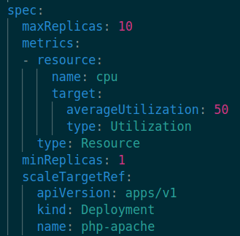
HPA specification
We can specify min number of pods for target.
Max number of pods.
This metrics will spawn new pod if average cpu utilisation across pods is above 50%

Slide 166
Demo
$ cd 021_autoscaling

Slide 167
ConfigMaps

Slide 168
Motivation
Sometimes apps in the kubernetes need some configuration to be presented.
This config is mostly presented as environment variable or file.
Remember that the pods are copies which does not persist between restarts but configmaps do.
ConfigMaps are stored in etcd but you should not put state into them!!
Their purpose is to keep configuration of application.

Slide 169
Creation
Just like everything you can use imperative or declarative syntax.
Configmaps can be created from literals (inline definition of name and value) or files.
$ kubectl create cm test-cm --from-literal name=michal

Slide 170
How to use configmap
Having configmap created we can use it in pods in different ways:
Mount all values from configmap as environment values in pods.
Mount some values from configmap as environment value in pods.
Mount configmap entries as volume files.

Slide 171
What is a volume?
It represents a directory which is presented for one or many containers of the pod.
Volume can outlive the container.
If there is a container restart data store on volume can be persisted.
Depending on the volume type it may or may not be persistent (stored)
In this video we talk about ConfigMap based volumes, from which we can just read data and not persist anything in them

Slide 172
Pod
Container 1
Container 2
Volume

Slide 173
Demo
$ cd 022_configmaps

Slide 174
Secrets

Slide 175
Motivation
Sometimes we want to store sensitive configuration for our apps.
There are many approaches how you can achieve that.
Most Kubernetes native way is to store this configuration is secret.
SECRETS ARE NOT THAT SECRET AS THEY SOUND LIKE.
By default secrets are stored as plain text in the etcd.
Anyone with pod creation capability can read the secret.

Slide 176
So what is Secret
It’s almost the same thing as ConfigMap.
It’s kubernetes object.
It helps to split the sensitive app configuration to separate object.

Slide 177
Basic Kubernetes secret types
generic
docker-registry

Slide 178
Demo
$ cd 023_secrets

Slide 179
Services basics

Slide 180
Problem
How can pods in the cluster communicate with each other?
How can be load distributed across nodes of deployment?

Slide 181
How networking works?
pods CIDR range 10.1.0.0/16 (that is default for microk8s)
Pod 1
Pod 2
10.1.112.252
10.1.112.241

Slide 182
Container network interface
Is the magic responsible for communication between pods and containers,
You should understand that the communication needs to be routed to a specific container in the pod (more about this later).
There are multiple CNI plugins which you can use in the cluster:
Canico (microk8s)
VPC CNI (EKS)
Weave works
Flannel
and more

Slide 183
Introducing Services
Service is a mechanism in Kubernetes to expose set of pods.
Using services you application does not have to adapt to mechanism of randomly assigning IP addresses.
Service is grouping of pods (using selector in most of the time) and set of access rules to those.
Kubernetes automatically ads/remove pods to services during their livecycle.

Slide 184
Service
Pod 1
Pod 2
10.1.112.252:80
10.1.112.241:80
Service
my-service:8080
10.152.183.224: 8080

Slide 185
Service dns
Now the ip address of the service is stable (its fronting unstable set of ip addresses for pods).
We can assign a valid dns to this address.
Now the pods does not need to remember ip addresses.

Slide 186
How is the traffic balanced?
Kubernetes kube-proxy is responsible for managing the routing of the requests between pods in the service.
This routing is handled via iptable rules.
This whole thing is very complex for now let’s keep things simple.

Slide 187
Demo
nginx-1
nginx-2
nginx-1-ip:80
nginx-2-ip:80
nginx-1-service
nginx-1-service:8080
service-ip: 8080

Slide 188
Demo 2
nginx-pod-1
nginx-pod2
nginx-pod3
nginx-deployment
nginx-service

Slide 189
Kubernetes DNS

Slide 190
Why DNS
Using dns records instead of ip addresses (even for unchanging services) is useful we never know what the ip address will be and we don’t care.
Using the dns records we can also refer to services between namespaces.
Query examples from pod:

Slide 191
service | searches for service with name service in same namespace as the pod
service.default | searches for service with name service in default namespace
service.default.svc.cluster.local | same as above (cluser.local is default domain name for the cluster)

Slide 192
DNS in Kubernetes
In cluster DNS is used by DNS component.
In microk8s and EKS it’s the CoreDNS (you can check pods in kube-system ns).
Core dns will update all needed dns record whenever new pod is created/deleted or new service.

Slide 193
Pod’s DNS
The same way as services got dns also each pod has its own dns record.
Remember that this record is closely coupled with the ephemeral pod.
pod-ip.namespace.pod.cluster.local | search for pod based on the ip address and namespace locator
pod-ip.service-name.namespace.svc.cluster.local | searches for pod in given service name in given namespace

Slide 194
Demo
$ cd 025_service_dns

Slide 195
NodePort

Slide 196
ClusterIP service
So far we were discussing about cluster wide name resolution and pod exposure.
Almost all the time we need to access the services also from outside of the cluster (e.g. some framework or API endpoint).
So far we covered ClusterIp services.
Its a default type if you expose service.

Slide 197
NodePort service
We will expose a service through a port on the node.
Cluster is made of nodes which are vms.
Each vm may have ip address accessible from the internet (e.g. the one we ssh).
For each machine we will expose service on one of its ports.
This port will serve as a gateway to access the service.

Slide 198
nginx-pod-1
nginx-pod2
nginx-pod3
nginx-deployment
Node 1
Node 2
nginx-service
nginx-service
Public traffic

Slide 199
NodePort
Pods can be scheduled on any node.
Service is bound to a specific port on each node.

Slide 200
Demo
$ cd 026_nodeport

Slide 201
LoadBalancer
Things are getting complicated (but don’t worry)

Slide 202
Problem
Living in the world of HTTP and HTTPs exposing the service on random nodeport is not that convenient (port :80 and :443).
The port range for nodeport is just 30000–32767.
There is a big problem if the ip address of VM changes.

Slide 203
Load balancer type of service
Its very special and non usable by default .
For each service of this type we will have an externally accessible IP and we can also specify port (most likely 80 or 443).
We need an external load balancer in order to use it.
It’s simple setup for public cloud but hard for local dev.

Slide 204
nginx-pod-1
nginx-pod2
nginx-pod3
ClusterIp
Node 1
Node 2
NodePort
NodePort
LoadBalancer

Slide 205
LoadBalancer problems
It’s just L4 routing (we can route based on ip and port no support for L7 routing).
We need to have unique IP:PORT for each service which we want to expose. This can get expensive having lots of services.

Slide 206
Demo Microk8s
$ cd 027_loadbalancer

Slide 207
Ingress

Slide 208
Motivation
Ingress solves the problem with l7 load balancing (it provides it).
We can use names based virtual hosting to route traffic.
We can use paths and headers to route traffic.
It exposes only HTTP or HTTPS routes (if we need any other port we should use NodePort).

Slide 209
Ingress controller
Is responsible for monitoring new ingress resources.
For assigning external ip to the ingress by talking to cloud provider or using some external hardware router.
There are a lot of them (third party thing) :
Nginx is the one I will demonstatriting (it is also used by EKS).

Slide 210
I have no idea what you just said michal
Imagine we have two apps and one domain (michalhucko.com).
We want to serve a api on:
api.michalhucko.com
And we want server a gallery app on:
gallery.michalhucko.com
Using normal load balancer would end up with provisioning 2 ip addresses and won’t solve the problem.
Alternatively we may want to have:
one app at www.michalhucko.com/api
second at www.michalhucko.com/gallery

Slide 211
deployment1
deployment2
deployment3
service1
service2
service3
ingres
svc1.host -> service1
svc2.host -> service2
svc3.host -> service3
LoadBalancer

Slide 212
Things to check
The whole ingress thing is still under development.
There are lot of controllers which use different annotations to achieve similar things.
It’s always good idea to check docs of tools you will use.

Slide 213
Demo
$ cd 028_ingress

Slide 214
Daemonsets

Slide 215
Motivation
Sometimes we want to create exactly one pod on each of the node:
E.g. we want to install some drivers on each of the machine (e.g. GPU drivers).
Or we want to update the iptables on each of the nodes (as some of the CNI plugins do).
One way is to specify nodeName field on the pod (this will disable scheduling for that pod as it will be always deployed to the same node).
But this gets complicated with couple of nodes.

Slide 216
What is daemonset
Daemonset spawns exactly one pod per node (by filling the nodeName parameter for us).
that mean scheduler is not handling these pods
That’s it :).

Slide 217
Demo
$ cd 029_daemonsets

Slide 218
Jobs

Slide 219
Motivation
Sometimes we want to run a specific code once (or few times).
Example is batch processing of data.
We want to run some processing function on piece of data.
To achieve this we can use Kubernetes Jobs.

Slide 220
Three types of jobs
Name | Parallelism | Completitions
One time job | 1 | 1
Parallel with fixed competitions | more than 1 | more than 1
ParallelJobs with a work queue | more than 1 | 1

Slide 221
Things to know about jobs
You can specify number of failed jobs to be kept so you can later inspect the error logs.
You can send indexes to jobs (e.g. if you need to access some window in db .spec.completionMode="Indexed").

Slide 222
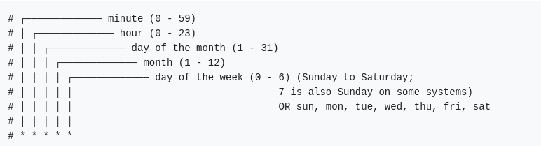
CronJobs
You can create also CronJobs (by specifying schedule and Job template).

Slide 223
Examples
0 0 * * * | Run every day
0 * * * * | Run every hour
0 0 * * 0 | Run every sunday
0 23 * * 1 | Run every monday at 23 00
*/2 * * * * | Run every two minutes

Slide 224
CronJob limitations
Bame must be valid dns with max of 52 characters !!!!
If you have a CronJob and you change it, changes will be effective to new jobs not to the once which were scheduled and are running.
For more refer to the docs.

Slide 225
Demo
$ cd 030_jobs_cronjobs

Slide 226
EmptyDir InitContainer

Slide 227
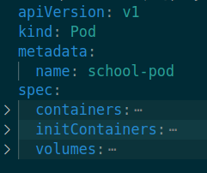
First talk about init containers
InitContainers are jobs which must be successfully executed before the app container is started.
Init containers have the same spec as normal app containers.
We put them instead of .spec.containes into .spec.initContainers
We use the initContainers for some pre application setup.
Creating tables.
Handling security related stuff.
Delaying main app.

Slide 228
Django and initContainers
We will use initContainers to create tables for our main application.
We will run python manage.py migrate which creates tables.
The init container will run the same image.
In this demo we use sqlite which creates the tables in files in the filesystem.
This means we need to share location between these containers.
Because the fs for initContainer disappears after container is done.

Slide 229
Pod
Container
InitContainer
Volume

Slide 230
Empty dir volume
It’s created when pod is created and its deleted when pod is deleted.
It’s just a scratch space.
Medium field:
By default it is using the storage of the node.
“Memory” will use tmpfs (RAM based volume).

Slide 231
Demo
$ cd 031_empty_dir

Slide 232
HostPath

Slide 233
Motivation
Sometimes we want to persist data between pods or pod restarts.
We showed something like this when we were mounting contigmap or secret as a volume.
Today we talk about hostpath.

Slide 234
HostPath
It’s a volume type where location on the node is used as volume in pod.
There are a lots of caveats we need to know
Data is available per node so you can share the data across pods only if they are scheduled on the same node.
Data is not synced across nodes.
It’s really insecure to use (as the app may cause problems to nodes filesystem).
There are options which can create provided directory if it does not exist.

Slide 235
Pod
Container
InitContainer
Volume
/data/location/path
Node

Slide 236
Demo
$ cd 032_host_path

Slide 237
StorageClass in Kubernetes

Slide 238
Persistent volumes
Persistent Volume is an abstraction in Kubernetes which helps to integrate Kubernetes cluster with storage offerings.
There are various storage offerings in each public cloud.

Slide 239
What is CSI container storage interface
It’s a specification which defines how a block and file storage should be connected to containers (e.g. inside pods).
Thanks to this we can just plug storage offerings from different vendors into Kubernetes cluster.

Slide 240
How does it work?
In order to use persistent network storage we need a provider for that.
Than we register the providers CSI driver to our cluster (most of the time this will create object called storage class).
Now everytime we will need some volume we will create Kubernetes object called persistent volume (this will take the storage class and will create the volume for us with specified size and access policies).
Now we can claim the volume with another object Persistent Volume Claim
After this we can mount the volume to a pod.

Slide 241
Benefits
The idea is that the cluster administrator will setup the CSI plugin for specific storage provisioner your company will use.
After that application developer or DevOps guy does not care about the underlying implementation of the csi. They just use StorageClas to create PVs and PVCs in their apps.
Using storage classes in cluster is example of Dynamic provisioning of volumes (otherwise the cluster admin would have to everytime create the volumes).

Slide 242
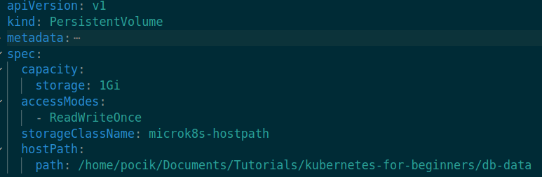
Persistent Volume
It’s a link between Kubernetes cluster and storage provisioner.

Slide 243
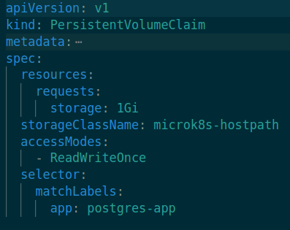
Persistent volume claim
Its link between PV and Pod (as pods are ephemeral). One to one relationship with PV.

Slide 244
PV AccessModes
ReadWriteOnce | PV is mounted on single node (can be used by multiple pods on single node)
ReadOnlyMany | PV can be mounted on multiple nodes and their pods but just for reading
ReadWriteMany | PV can be mounted on multiple nodes and their pods for reads and writes
ReadWriteOncePod | PV can be mounted only to single pod (new feature 1.22+)

Slide 245
Some storage provisioners
Provisioner | RWO | ROX | RWX | RWOP
AWSElasticBlockStore | x | - | - | -
AzureFile | x | x | x | -
AzureDisk | x | - | - | -
GCEPersistentDisk | x | x | - | -
microk8s-hostpath | x | - | - | -

Slide 246
StorageClass reclaimPolicy
Specifies what will happen if the PV will be reclaimed:
Retain: volume and data is kept.
Delete: volume data is deleted at pods end.
Recycle: volume is scrubbed (this is still supported only by hostpath and NFS provisioner).

Slide 247
Demo microk8s
$ cd 033_persistent_volumes_microk8s

Slide 248
Deploying Django App

Slide 249
Plan
Deploy singleton database to the cluster (Postgresql) with persistent data.
Deploy Django and connect it to the database.

Slide 250
credentials
init.sql
Postgres-deployment
Django-deployment
Postgres-service
Django-service
db-pvc
db-pv
Ingress

Slide 251
Demo
$ cd 034_full_deployment

Slide 252
StatefulSets

Slide 253
Original design
So far we were talking about stateless design.
Although some of the state was kept in DB for our last example most of the examples were stateless.
Pods were copies and did not have to know about each other.
Order of Pods startup did not matter.
That's why we have StatefulSets.

Slide 254
StatefulSet
On first glance they look identical to replicasets but;
Each pod in Statefulset is unique (e.g. they got unique host names indexed from 1).
This identifier is kept during scheduling.
Replicas are created in given order (by the index) and if previous replica fails all the following will wait for restart.
On scale down the reverse index order is taken.
With stateful sets we can create dedicated volumes for each pod in the set.

Slide 255
Gochas
PVs needs to be precreated or auto provisioned by the storage provider
PVs are not deleted on pod’s deletion
To expose this Statefullset a Headless service needs to be manually created
Deletion does not guarantees the ordered removal of pods

Slide 256
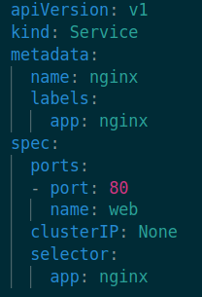
Headless service
In Statefull sets we don’t want to load balance traffic between pods, we want to sent traffic directly to specific pods (distinguished by the hostname of pod).
We create Headless services for this use case
Set the ClusterIp section to None.
You can refer to pod with hostname.service.

Slide 257
Demo
$ cd 035_statefullsets

Slide 258
Kubernetes Authentication

Slide 259
Core concept
Each request to kube-api is connect with identity (there are even anonymous requests).
Authentication is response to question Who am I?
Kubernetes provides two kinds of objects for authentication.
Service accounts (handled by Kubernetes itself).
User accounts (this needs to be managed by something else than Kubernetes).
There are multiple authentication methods available:
Bearer token (mostly for service accounts)
Certificates
Proxy authentication

Slide 260
Service accounts
Are bound to a namespace.
Are created automatically or manually.
Each pod in the cluster has mounted service account which allows him to talk to kubernetes api (this kind of credentials are stored in namespace as configmap).
You can specify custom serviceaccount for pod with .spec.serviceAccountName.

Slide 261
Using service account outside cluster
Service account bearer tokens are perfectly valid to use outside the cluster and can be used to create identities for long standing jobs that wish to talk to the Kubernetes API.
You can create them with kubectl create sa <name>.
And then you can create token for it kubectl create token <sa-name>.

Slide 262
The identity
Kubernetes tries to extract this from identity.
username
UID - unique ide
groups - user can belong to one or more groups
If we use certificate based authentication these data is included in certificate.

Slide 263
User accounts
In order to “create a new user” in the cluster we need to create private-key (for the new user) and certificate sign request which needs to be approved by the cluster (signed).
Its outside of scope for common developers.

Slide 264
Demo
$ cd 036_authentication

Slide 265
Kubernetes Authorization

Slide 266
Motivation
With authorisation we answer the question Can I do this?
Can I list pods in this namespace as user X?
Can I create a pod in this namespace as user Y?

Slide 267
RBAC - Role based access control
Its Authorization mechanism in Kubernetes.
It’s not enabled by default (although it is in EKS) by design.
It's based on set of Roles and RoleBindings.
Role is a set of permissions for K8s resources within particular namespace.
RoleBinsing is mapping of role to particular user/group of users.

Slide 268
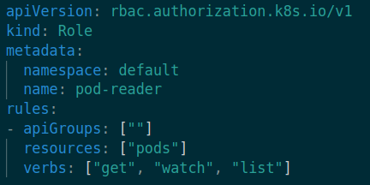
Role example

Slide 269
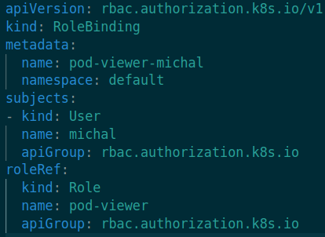
Role binding

Slide 270
ClusterRole ClusterRoleBinding
Some resources are namespaced:
pods, deployments, configmaps …
But some resources are not namespaced:
namespaces, users, csrs …
Cluster Roles are dedicated for non namespaced resources.

Slide 271
Demo

Slide 272
CKAD: Blue Green deployment

Slide 273
Motivation
Application is running in production with version 1
We want to deploy a new version of application version 2
The rollout deployment will cause that some of the pods serving the app may be in two different versions at the same time. This can be problematic for some kind of applications.
E.g. the database may have problem with some breaking changes or other components.

Slide 274
Blue Green Deployment
The Idea is that at a time we will run only one version of the application (either blue or green), while the other version (blue or green) is preparing in the background (e.g. deploying).
After the new version of the application is prepared the traffic will be directly switched to that version.

Slide 275
Blue Deployment
Public traffic

Slide 276
Blue Deployment
Green Deployment
Public traffic

Slide 277
Blue Deployment
Green Deployment
Public traffic

Slide 278
Pros
It’s always 1 version of the publicly accessible application.
Simple rollback (just point the traffic to the old version).
You can do testing in production environment before changing the traffic.
0 downtime.

Slide 279
Cons
You need extra resources for second deployment to be presented.
Second deployment is in production environment (How will the database behave …)
Maintenance issues.

Slide 280
Realisation 1
You can specify maxSurge on deploymentStrategy to 100%.
This will create the same amount of extra pods for the second version of the application.
This approach expects flawless probes to spot problem before switching to the new version.

Slide 281
Realisation 2
You deploy second deployment with different labels for the new version.
Now after the second version is ready you change the selector of the loadBalncer for the service handling the production traffic.

Slide 282
Demo

Slide 283
CKAD: Canary deployment

Slide 284
Idea
The best way to test new version of the app is by putting it to production.
Canary deployment deploys the new version of the app to production but it shifts just percentage of public traffic to the newest version.
Idea is to disrupt smaller amount of customers before going 100% live.

Slide 285
v1 Deployment
v2 Deployment
5%
Public traffic

Slide 286
Pros
Canary deployment is tested on real production data before affecting 100% of customers.
It’s easy to roll back
0 downtime

Slide 287
Cons
The traffic handling can be problematic.
Application and other microservices need to be ready to speak with 2 versions of the same application.

Slide 288
Realisation
In production most of the time service meshes are used (those are outside of the scope of this course and CKAD)
You can achieve cannary with 2 deployments and two ingress rules.
Rules will be the same but most of the time ingress controllers support annotation which specifies what size of traffic should go to canary deployment.

Slide 289
Demo
$ cd 039_canary_ingress_example

Slide 290
CKAD jsonpath

Slide 291
Motivation
Sometimes we want to access some specific field in the kubernetes object.
For example we want to automate something or we want to edit something with scripts

Slide 292
What is JSONPath?
It is a query language for JSON
Is an alternative to XPath in XML
We can get specific fields in json
$ kubectl get pods -o=jsonpath='{@}'

Slide 293
JSONPath basic functions
@ | This object | '{@}'
. | Access field | '{.spec}'
.. | Parent | ..field
* | Wildcard for all objects | .containers[*]
[start:end:step] | Slice index | container[0:2:1] container[0]

Slide 294
JSONPath basic functions
?() | Condition | ‘{.containers[?(@.name=="target")].image}’
range, end | Iterator | '{range .containers[*]}[{name}, {.image}] {end}'

Slide 295
Demo
$ cd 040_jsonpath

Slide 296
CKAD custom columns

Slide 297
Custom columns
Sometimes is useful to adjust the output of kubectl commands
Besides the jsonpath we can use custom column to adjust the output

Slide 298
Demo
$ cd 041_custom_columns

Slide 299
AWS account creation

Slide 300
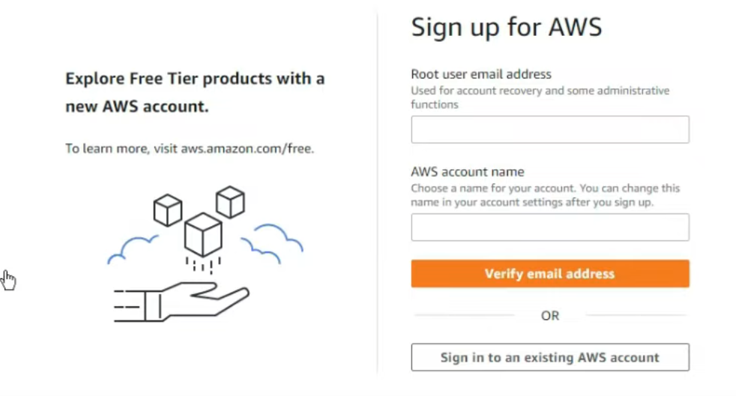

Slide 301
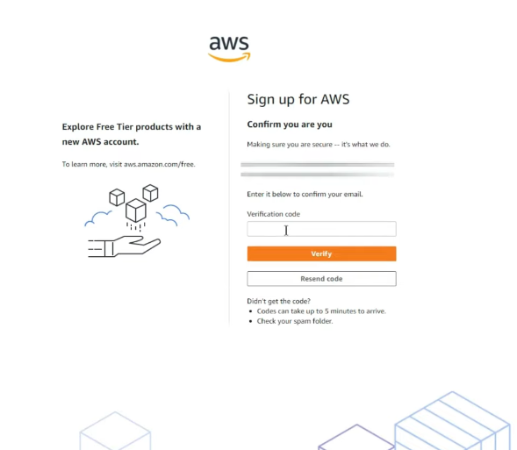

Slide 302
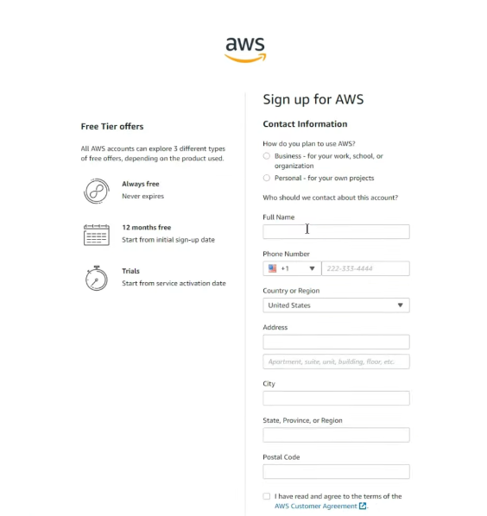

Slide 303
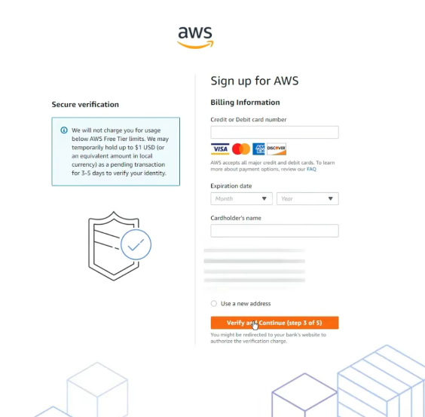

Slide 304
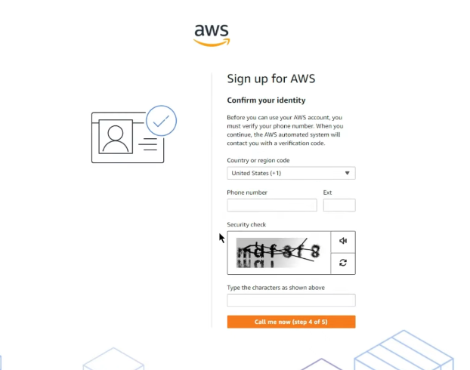

Slide 305
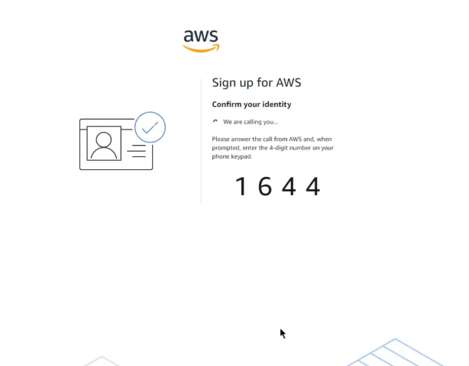

Slide 306
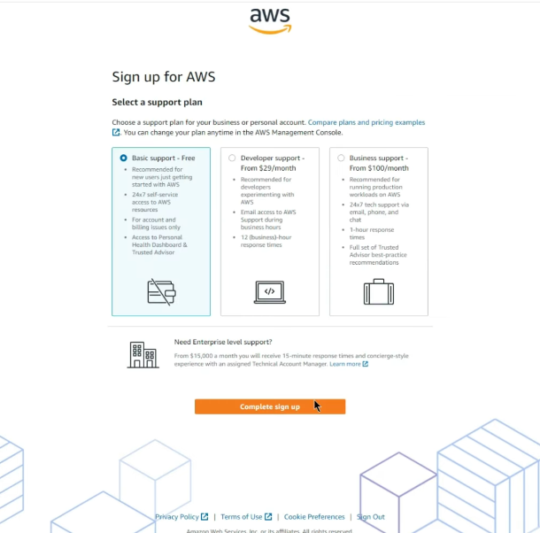

Slide 307
